Slide 1
Genetic interaction networks using SATAY

Slide 2
Recap Transposon Sequencing
Centromeric plasmid containing tn
Tn sequence flanked by Ade2
Transposition induced by transposase
After transposition, Ade2 repaired
Cells grow in -adenine medium
MiniDs
Gene
Transposition
Gene
MiniDs
Gene
Gene inhibition
Tn insertion mimics gene deletion

Slide 3

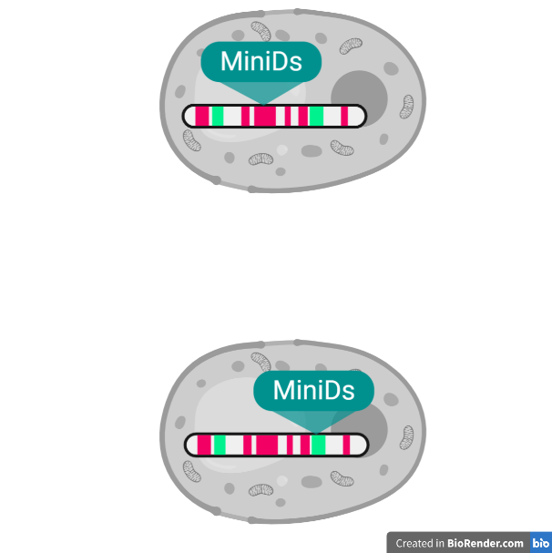
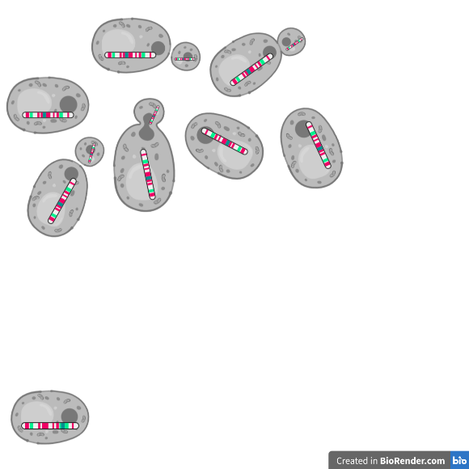
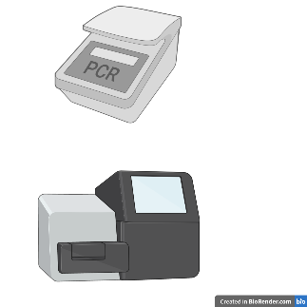
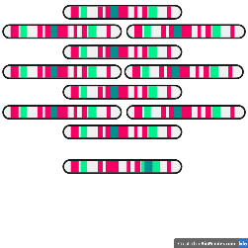
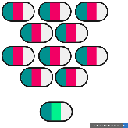
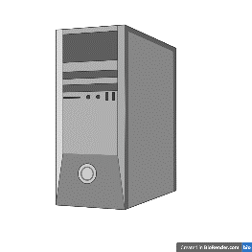
Recap Transposon Sequencing
Essential genomic region
Nonessential genomic region
Transposon
Transposon insertion in nonessential gene
Locations of transposon insertions
Transposon insertion in essential gene
# reads per genomic region
Reseed cells
Extract DNA
Digestion
Ligation, PCR and sequencing
Processing

Slide 4
SATAY measures growth phenotype
Reads per transposon represents growth phenotype
SATAY on WT strain measures growth phenotype all possible single gene inhibitions
SATAY on KO-strain measures growth phenotype double gene inhibitions
Allows us to determine genetic interactions

Slide 5
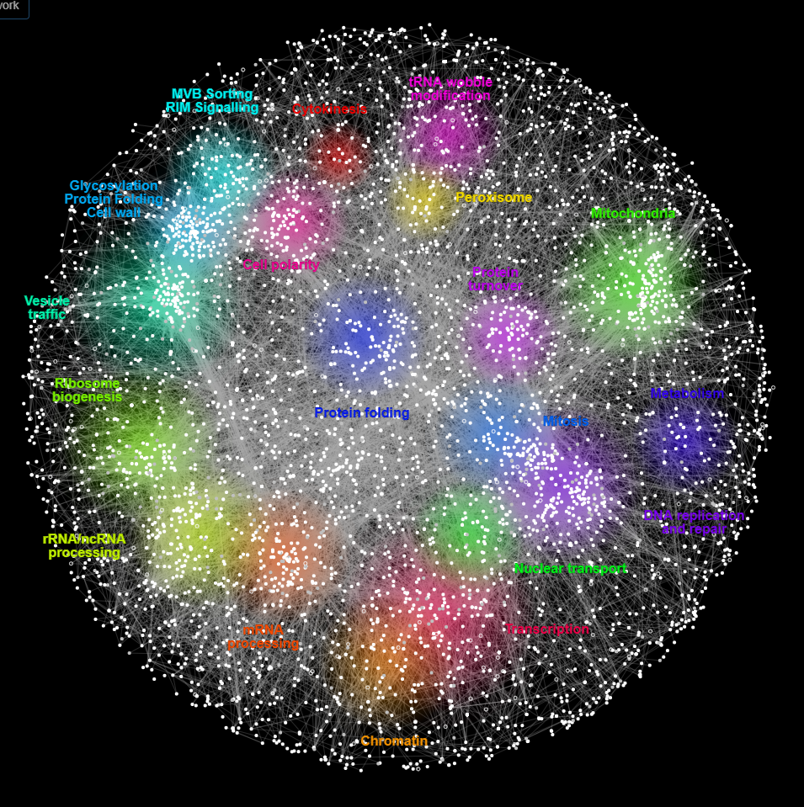
Existing interaction maps
Costanzo, M., Kuzmin, E., van Leeuwen, J., Mair, B., Moffat, J., Boone, C., & Andrews, B. (2019). Global genetic networks and the genotype-to-phenotype relationship. Cell, 177(1), 85-100.

Slide 6
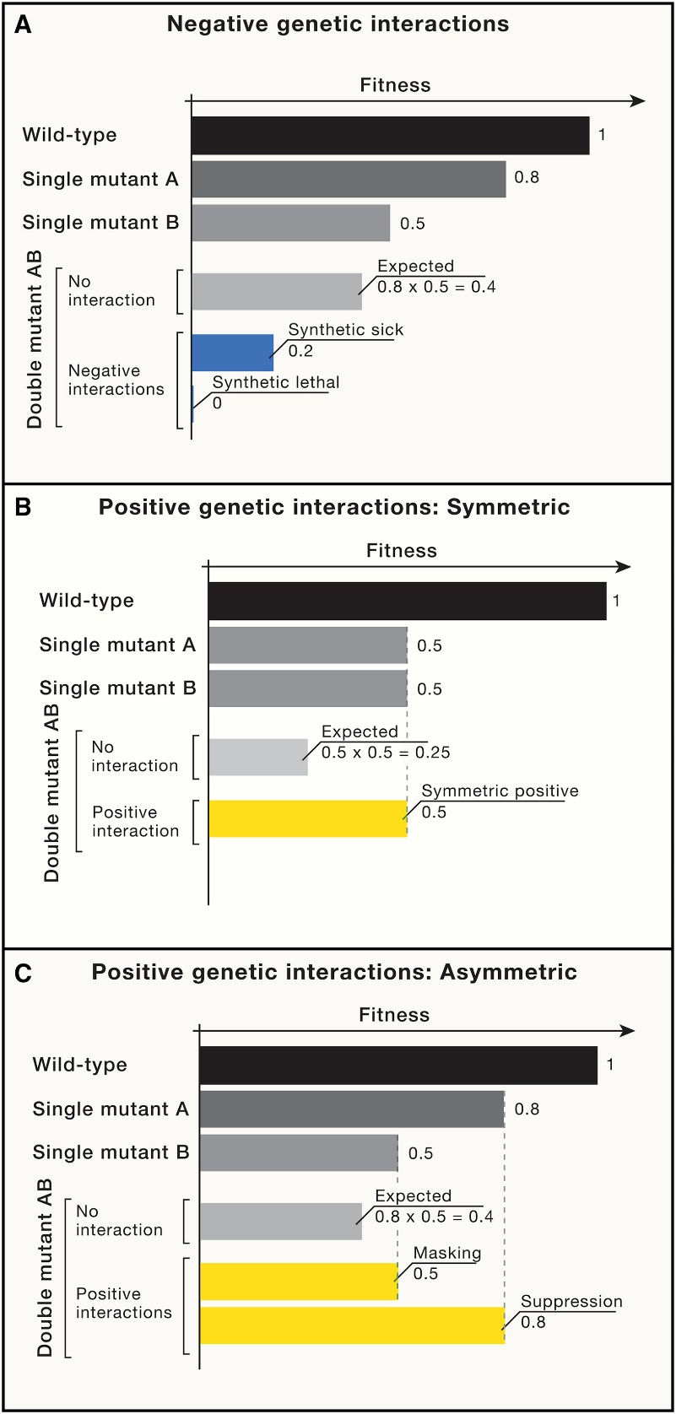

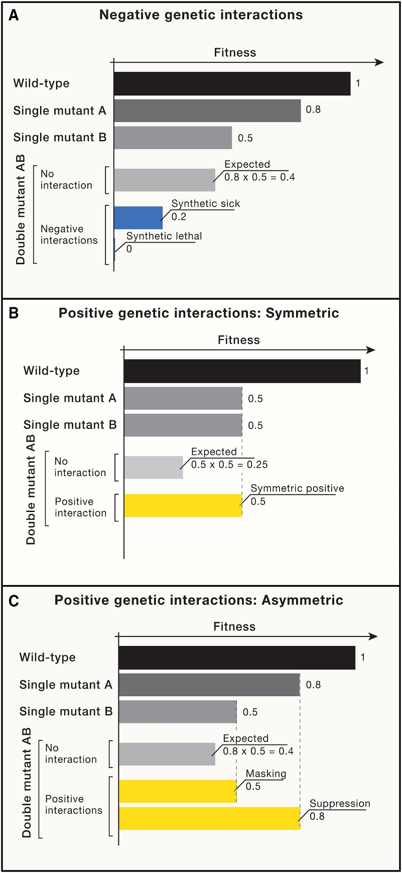
Existing interaction maps
Fitness based on growth phenotype
Calculation assumption: No genetic interaction
Costanzo, M., Kuzmin, E., van Leeuwen, J., Mair, B., Moffat, J., Boone, C., & Andrews, B. (2019). Global genetic networks and the genotype-to-phenotype relationship. Cell, 177(1), 85-100.

Slide 7
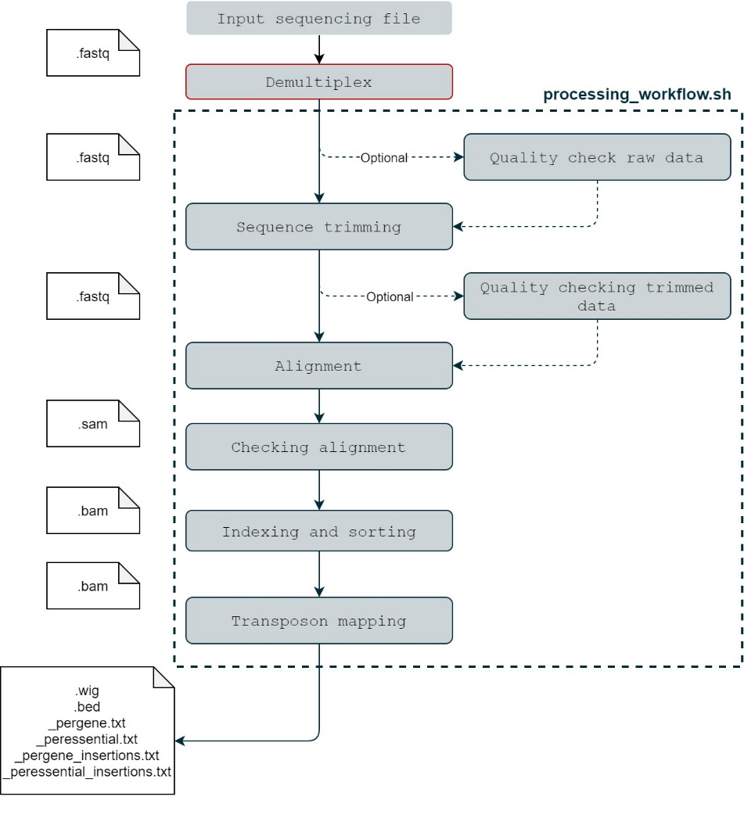
Processing SATAY

Slide 8
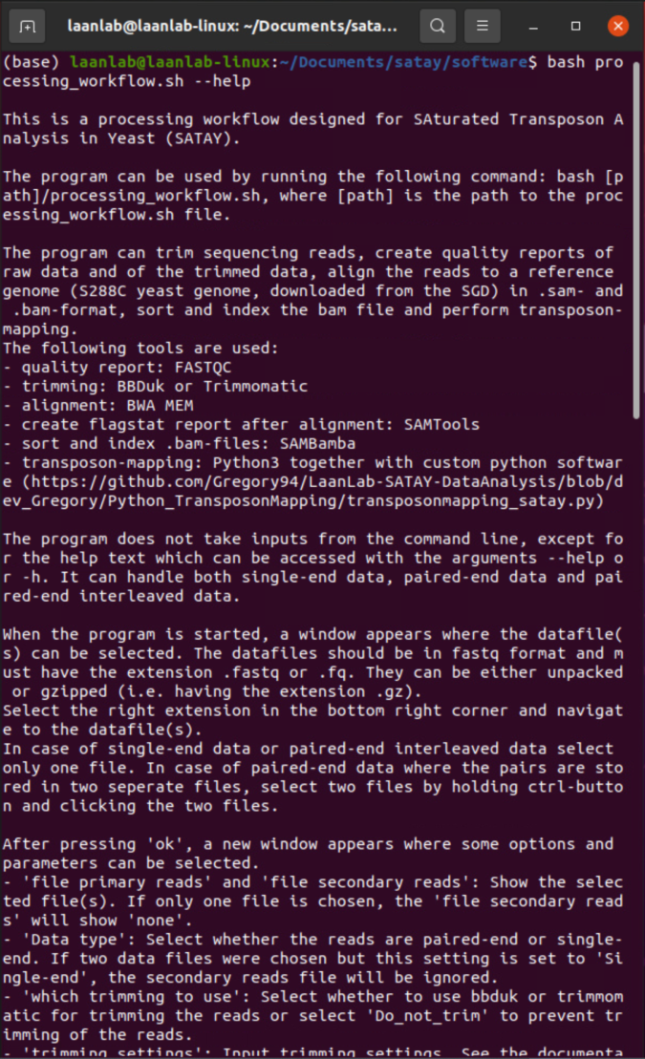
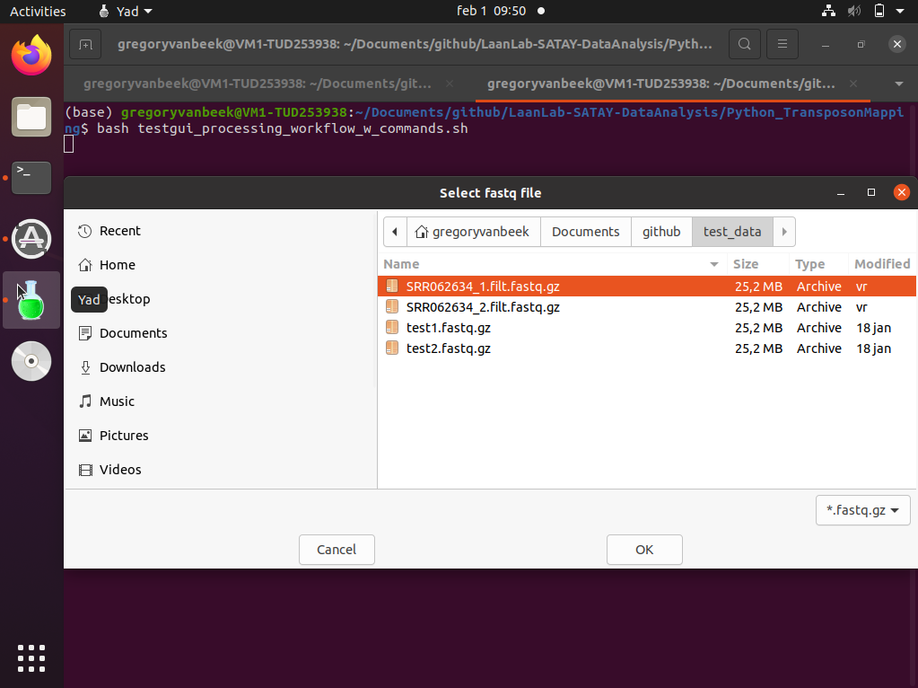
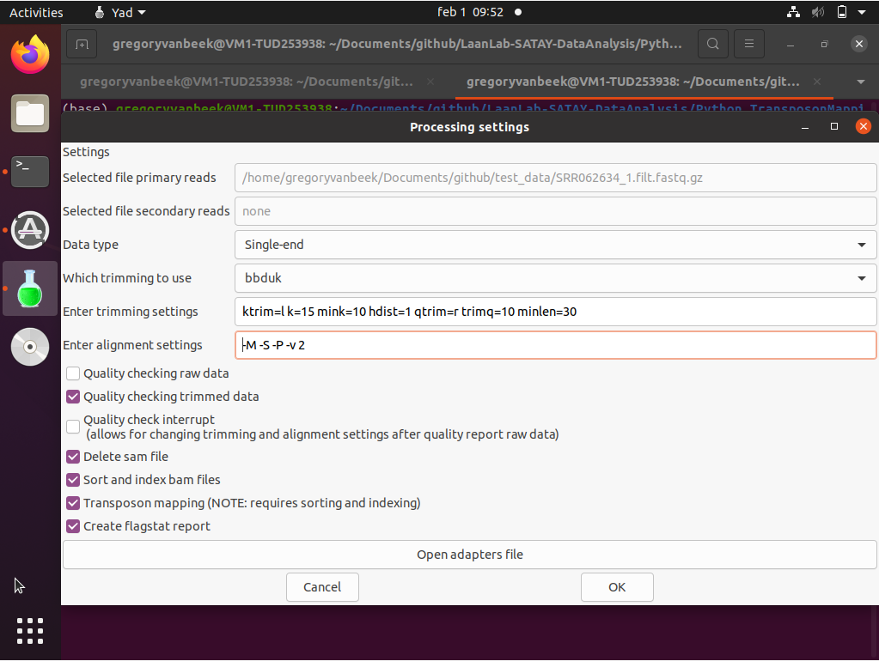
Processing SATAY

Slide 9
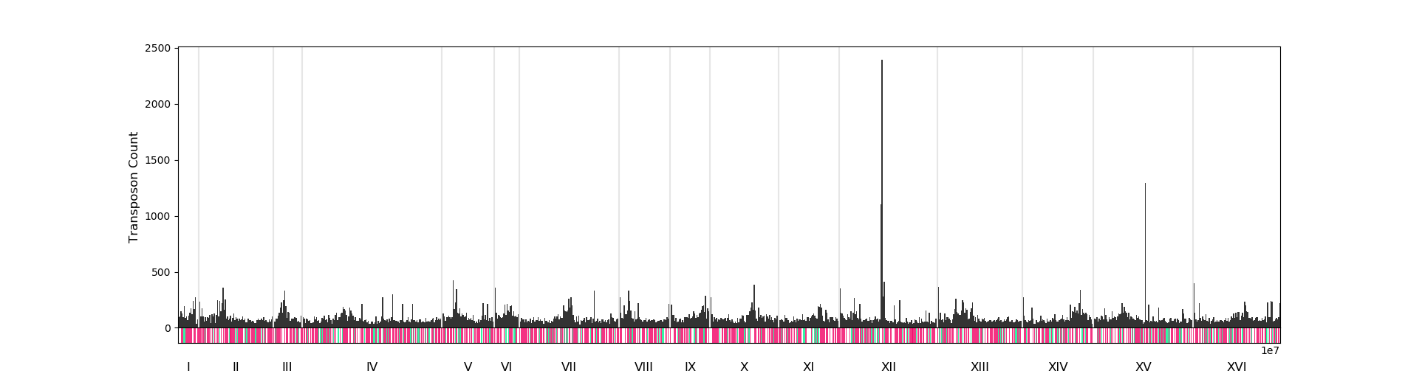
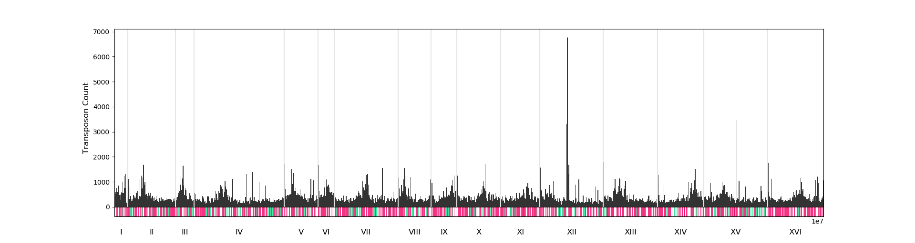
Interpret SATAY – Transposon count
Wild-Type
ΔBem1ΔBem2
ΔBem3ΔNrp1

Slide 10
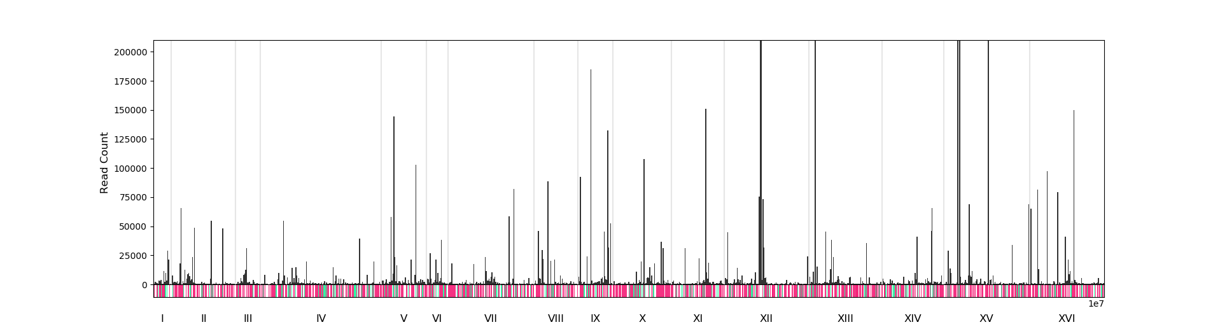
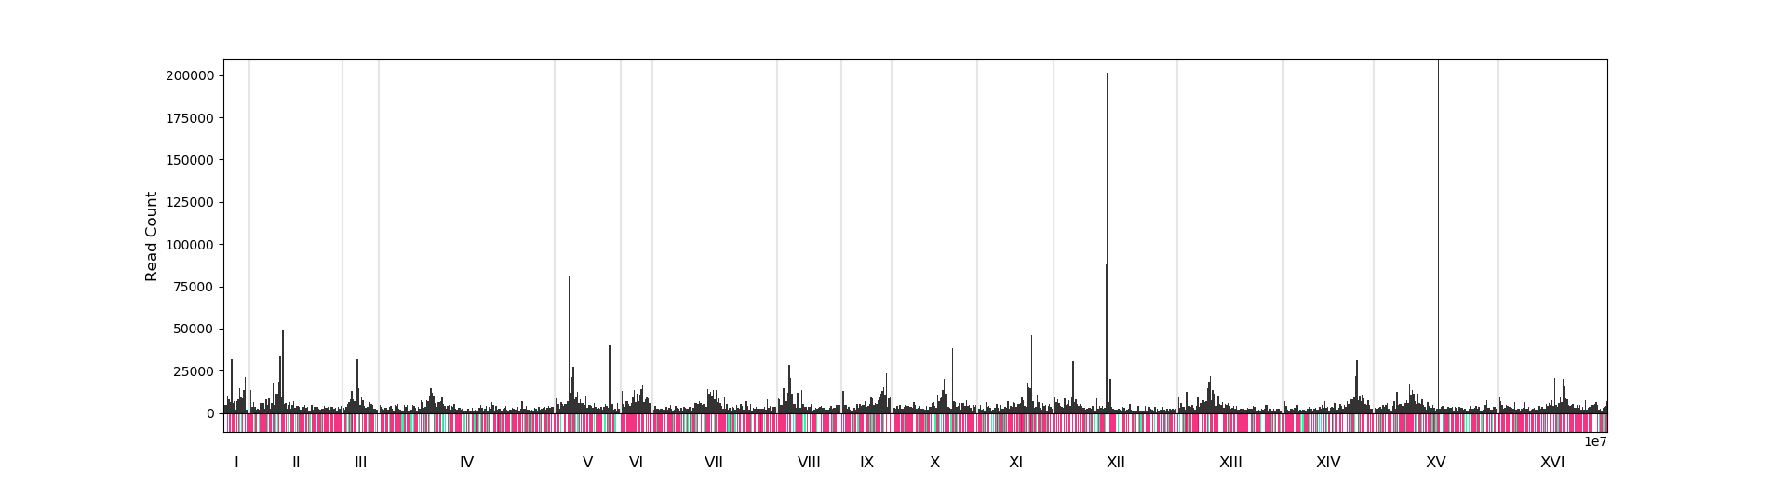
Interpret SATAY – Read count
Wild-Type
ΔBem1ΔBem2
ΔBem3ΔNrp1

Slide 11
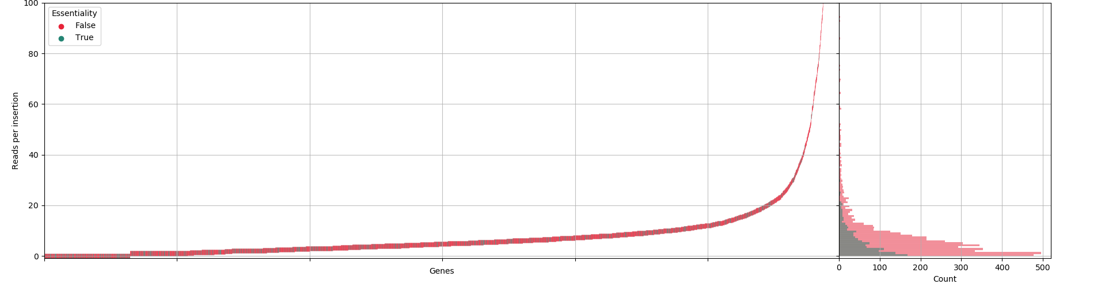
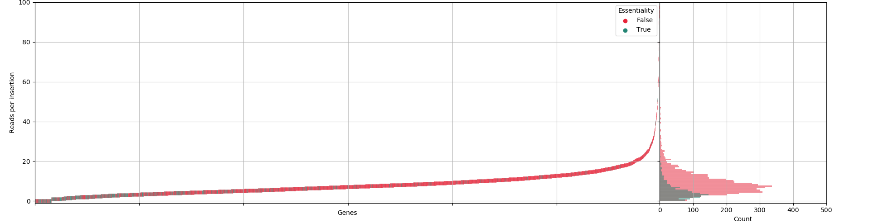
Interpret SATAY
Wild-Type
ΔBem1
ΔBem2
ΔBem3
ΔNrp1

Slide 12
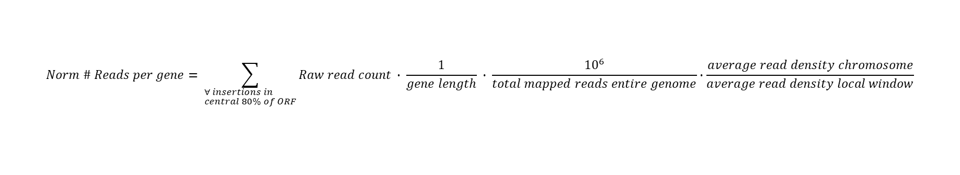
Normalizing reads
Normalize for:
Gene length
Experimental differences
Local deviations in transposon density
$$Norm \# Reads per gene= \sum_{\begin{aligned}&∀ insertions in \\ &central 80\% of ORF\end{aligned}}{Raw read count ∙ \frac{1}{gene length} ∙ \frac{{10}^{6}}{total mapped reads entire genome}∙\frac{average read density chromosome}{average read density local window}}$$
Gallagher, L. A., Shendure, J., & Manoil, C. (2011). Genome-scale identification of resistance functions in Pseudomonas aeruginosa using Tn-seq. MBio, 2(1).

Slide 13
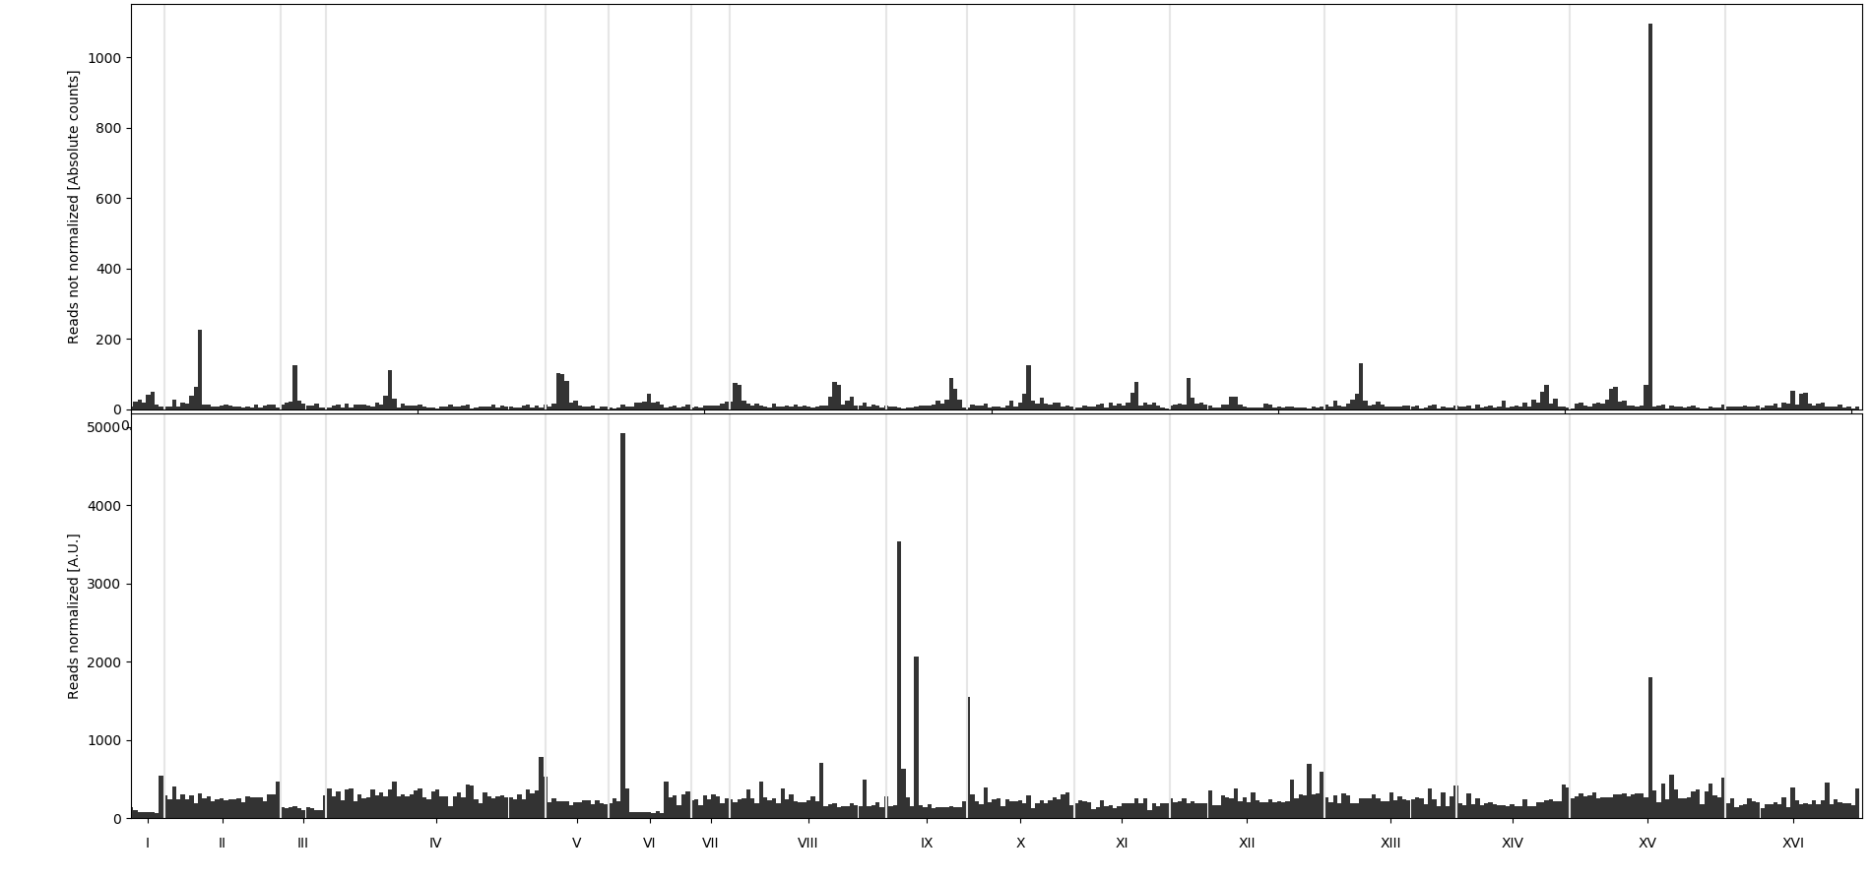
Normalizing reads

Slide 14
Normalizing reads
Issues:
Dependency window size
Normalization does not equalize between chromosomes
Isolated peaks

Slide 15
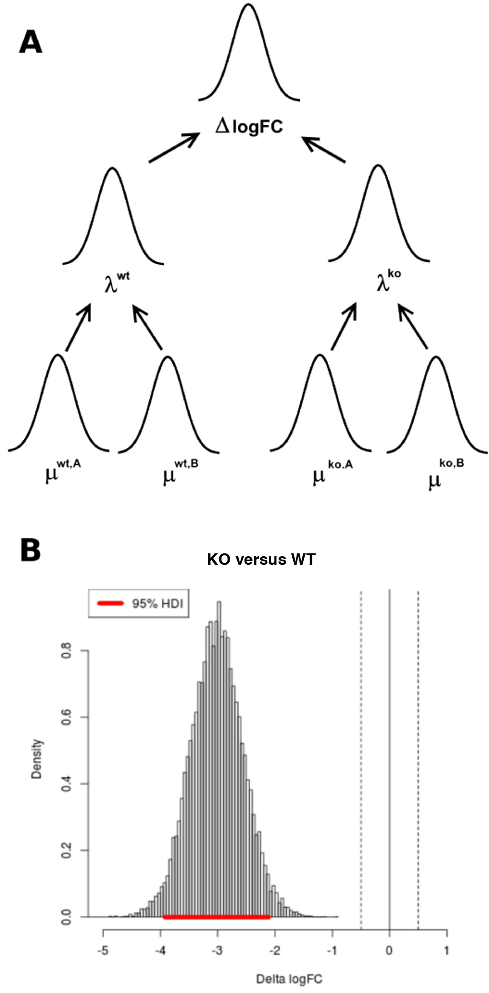
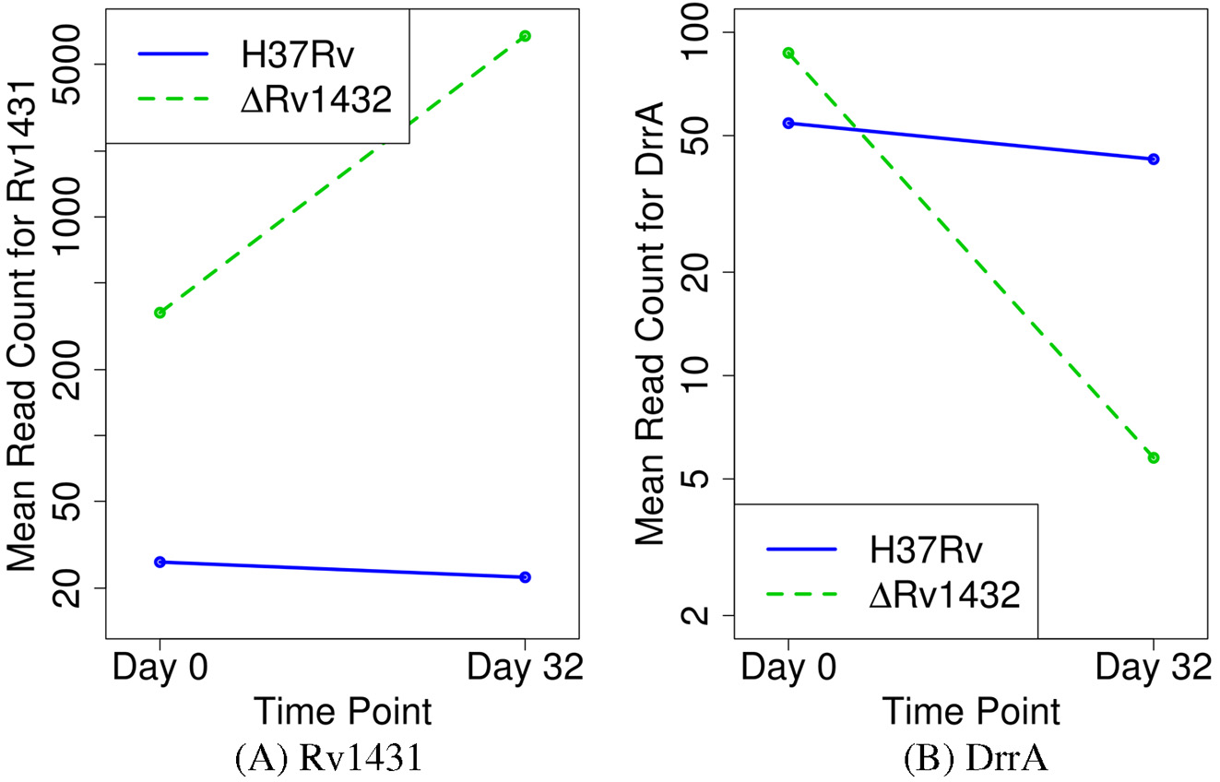
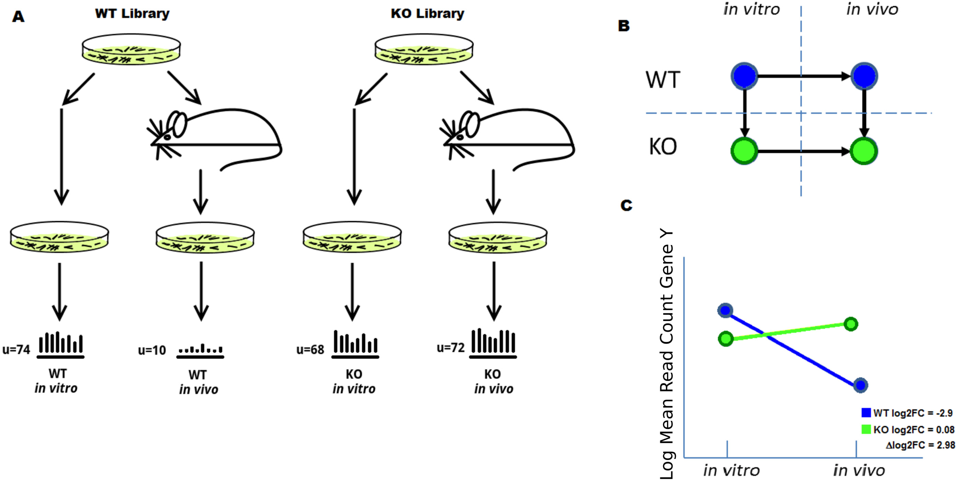
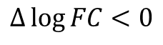
Dealing with stochasticity
Negative interaction
Positive interaction
Suppressive interaction
$$Δ\log{FC}<0$$
$$Δ\log{FC}>0; \left|\log{FC^{KO}}\right|< \left|\log{FC^{WT}}\right|$$
$$Δ\log{FC}>0; \left|\log{FC^{KO}}\right|> \left|\log{FC^{WT}}\right|$$
DeJesus, M. A., Nambi, S., Smith, C. M., Baker, R. E., Sassetti, C. M., & Ioerger, T. R. (2017). Statistical analysis of genetic interactions in Tn-Seq data. Nucleic acids research, 45(11), e93-e93.
Notes:
Suppress stochasticity.
Two libraries, two different timepoints after reseeding.
For each gene determine the mean read count by Bayesian Statistics.
Difference between a gene in two conditions gives log fold change that should inhibit transposition bias.
When the difference between two libraries deviates significantly from 0, there is a genetic interaction.

Slide 16
Discussion
SATAY can be used for finding genetic interactions
Remaining tasks:
Normalization
Finding cause of noisy WT-dataset
Create software package
Writing documentation for software pipeline

Slide 18
Title
Some text

